Slide 1

Interfacing LoRa SX1276 with STM32 Microcontroller | LR1276-915MHz |
TEAM MEMBERS: GUIDED BY :
E.G.PRADEEP(RA2211004050026) DR.MADHAN KUMAR
B.PRASANTH(RA2211004050008)

Slide 2
INTRODUCTION: LoRa (Long Range) technology is a low-power, wide-area network (LPWAN) wireless communication system designed for long-range data transmission in IoT (Internet of Things) applications. It is based on a proprietary modulation technique developed by Semtech that enables robust communication over distances up to 10 km or more

Slide 3
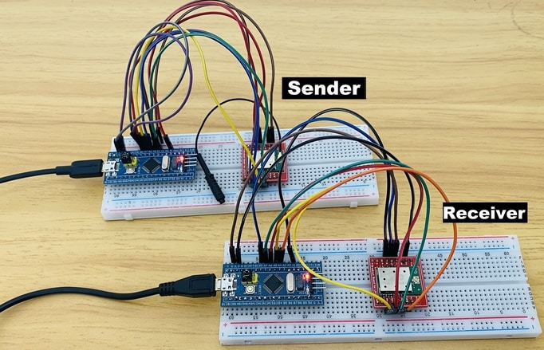

Slide 4
Components required →STM32 Microcontroller (e.g., STM32F103C8T6 or STM32F407) → LoRa SX1276 Module (915 MHz version). → Jumper wires and breadboard (for prototyping). → Power supply (e.g., 3.3V for both STM32 and LoRa module). → Antenna (to improve range). → Optional: Logic level converter (if voltage mismatch exists).

Slide 5
MOTIVATION : →To include lora technology in stm32 projects. →To increase the frequency range. →To include multiple nords to a single receiver in that particular range to transmit signals.

Slide 6
REFERENCES: 1. Design of low power LoRa module based on STM32 micro-controller Qianwen Wang, Lihong Zhao, Henghua Jiang, Caiyi Wei 2. Centralized Control System for Smart Street Lights Based on STM32 and LoRa Yuanchi Qu, Yanhua Yang, Yaoyao Li

Slide 7
THANK YOU

